Slide 1
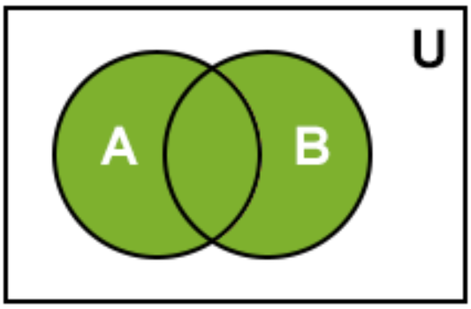
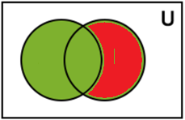
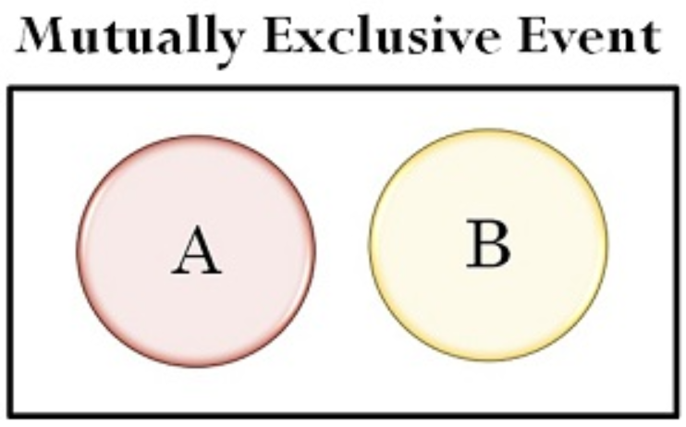
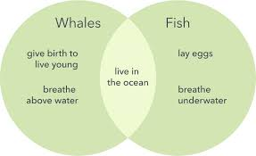
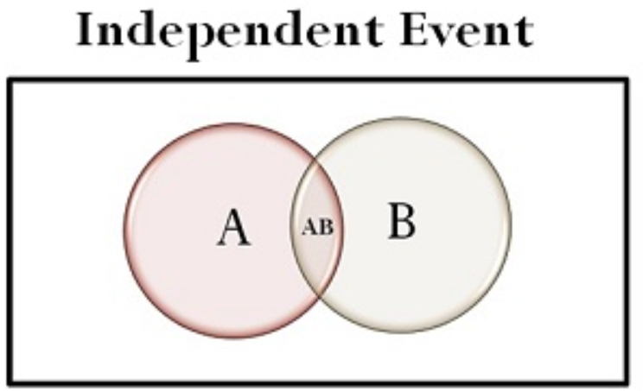
Lesson 4: 22.4 Finding the Probability of Overlapping Events
Name:__________________________
Period:_______
Determine if mutually exclusive:
You rolled a number cube.
Event A: Roll an even number.
Event B: Roll an odd number.
Remember the Concept
Two events are mutually exclusive if they have “nothing” in common.
1. Write the events using set notation.
$$U=\{1,2,3,4,5,6\}$$
$A=\{2,4,6\}$ and $B=\{1,3,5\}$
2. Draw a Venn Diagram
Empty
ACTIVATE PRIOR KNOWLEDGE
A
B
3. Determine if the two events are mutually exclusive
Make the Connection
Students, you already know how to determine if two events are mutually exclusive. Today, we will learn how find probabilities of Overlapping Events.
The process used in the mutually exclusive events can be generalized to give the following formula:
Recall Distributive Property:
Two events are ______________ (or inclusive events) if they have one or more outcomes in common.
Remember the Concept
Intersection (AND): A ∩ B Each element is in both set A and set B. Find where the sets overlap. Union (OR): A ∪ B All elements in set A or set B. Join together all of the elements in both sets. Complement: $A^{C}$of a set A refers to all elements in the given universal set U that are not in A.
Overlapping Events
Concept Development
Remember the Concept
If the intersection is _________, the events are mutually exclusive.
If the intersection is ___________, the events are Overlapping (inclusive events).

Slide 2
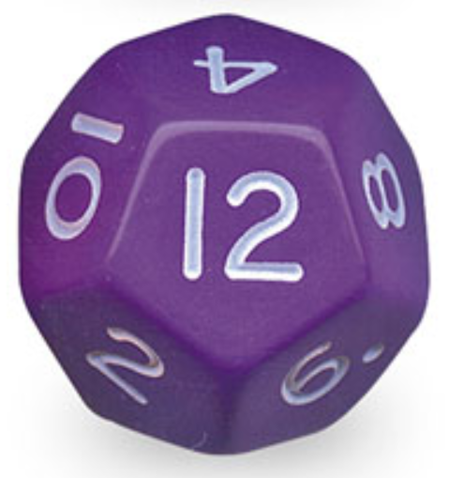
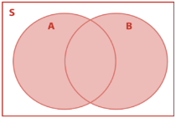
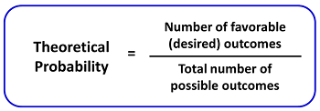
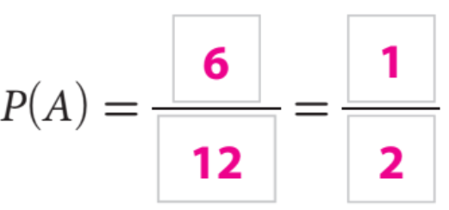
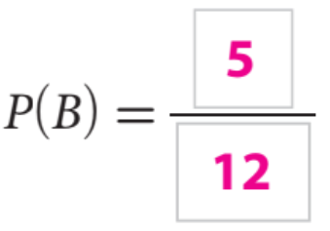
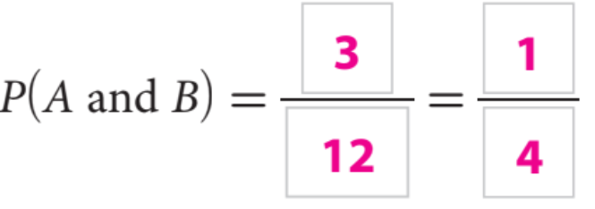
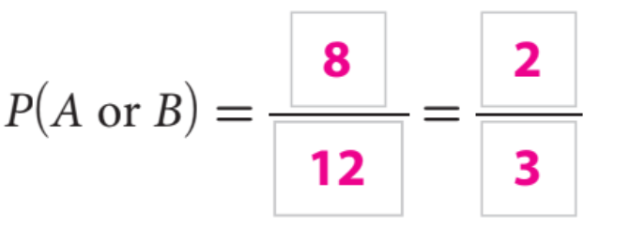
Find the Probability of Overlapping Events.
Steps
1. Define the events. “Write them in Set Notation.”
CFU How did you/I determine the event?
2. Draw a Venn Diagram.
CFU How did I/you draw a Venn Diagram?
3. Find P(A), P(B), P(A and B), and P(A or B).
CFU How did I/you find each probability?
4. Addition Rule.
CFU How did I/you I calculate the P(A or B)?
What is the probability that you roll a number dodecahedron cube and the result is an even number or a number greater than 7?
1. Write the events using set notation.
$$U=\{ \}$$
$A=\{ \}$ and $B=\{ \}$
Skill Development
2. Draw a Venn Diagram
3. Find P(A), P(B), P(A and B), and P(A or B).
4. Addition Rule
How do you find the probability of mutually exclusive events and overlapping events?
Overlapping Events
“Inclusive”
_______________
___________________
Skill Development

Slide 3
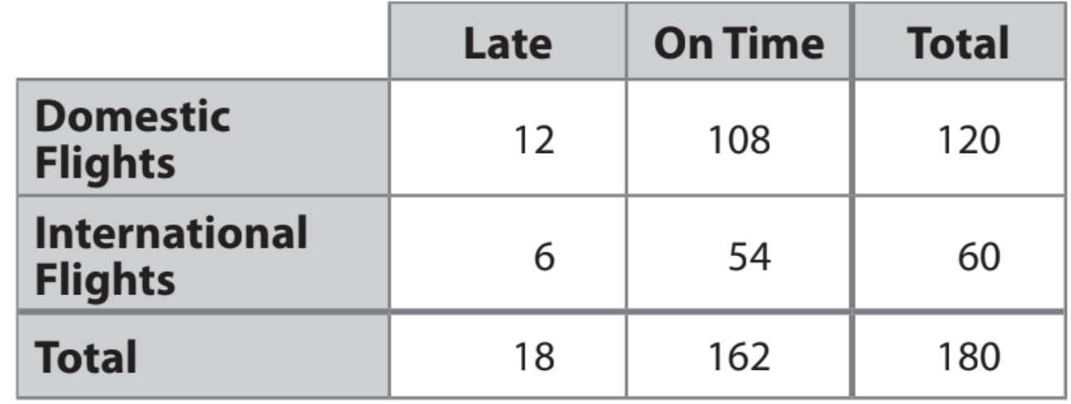
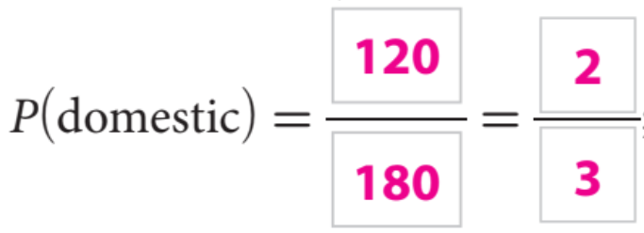
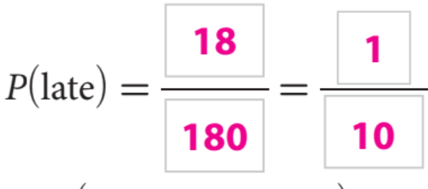
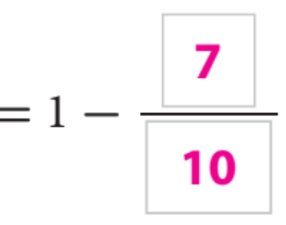
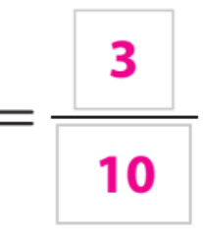
Complement: 1 - P
Skill Development
Essential Question Check-In: How do you determine the probability of Mutually Exclusive events and Overlapping events?

Slide 4
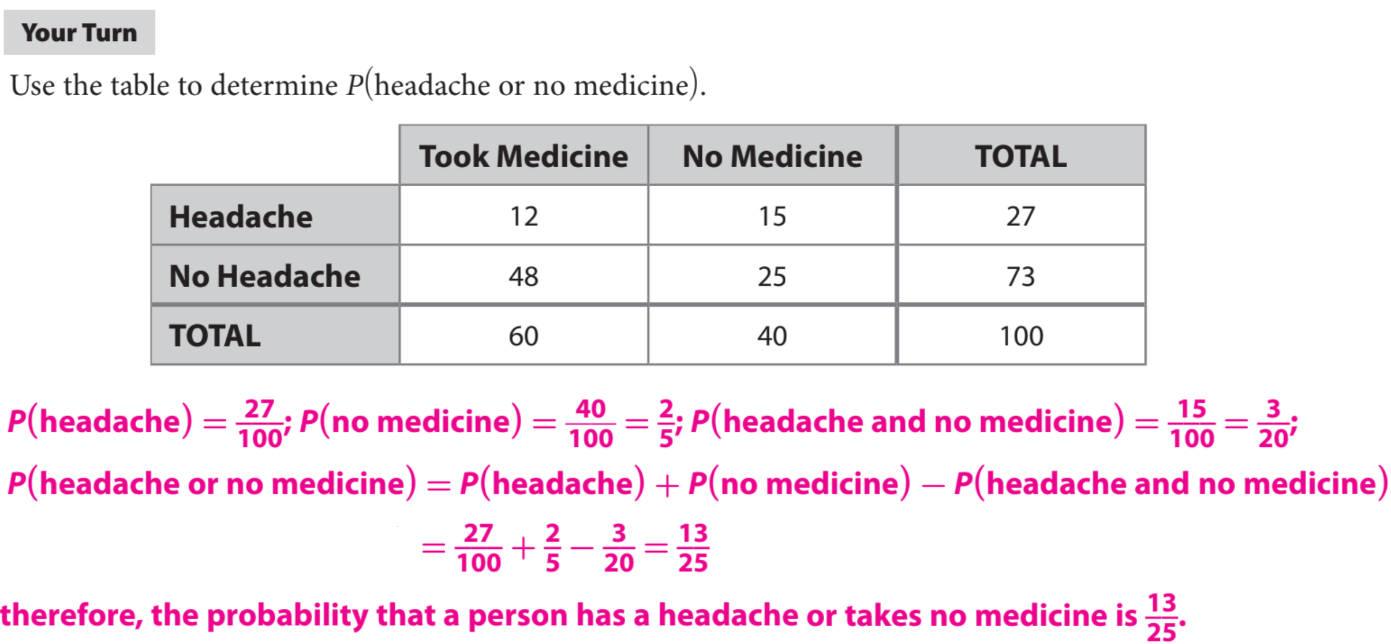
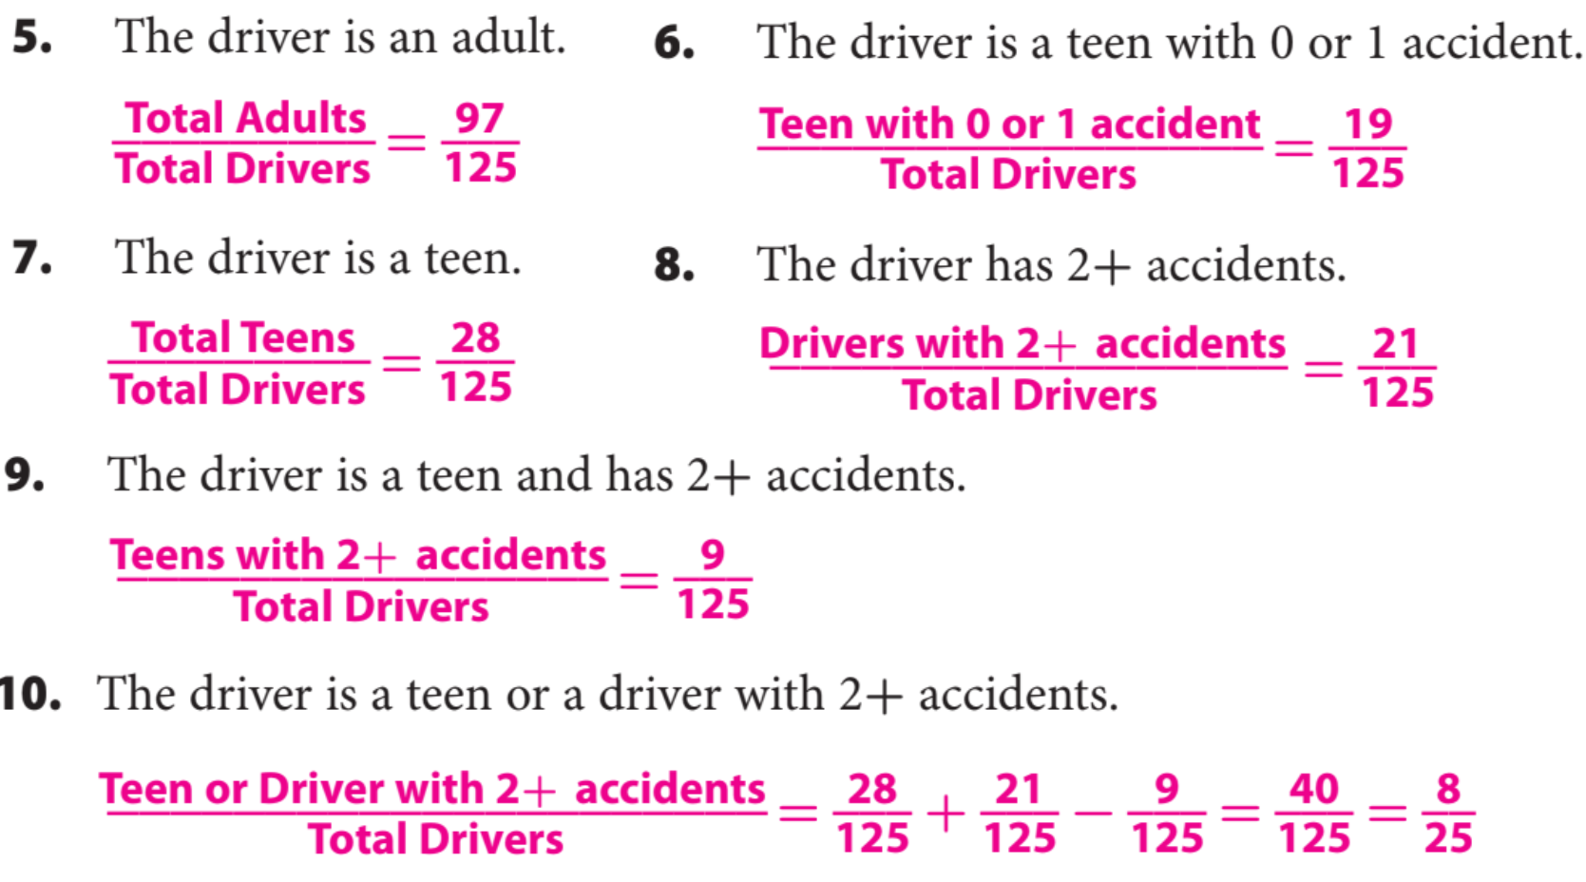
Homework
The table shows the data for car insurance quotes for 125 drivers made by an insurance company in one week.
Homework

Slide 5
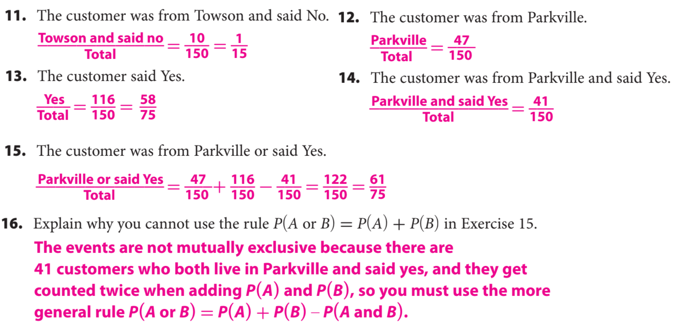
Use the following information for Exercises 11–16. The table shown shows the results of a customer satisfaction survey for a cellular service provider, by location of the customer. In the survey, customers were asked whether they would recommend a plan with the provider to a friend.
One of the customers that was surveyed was chosen at random. Find the probability of each event.
Homework

Slide 6
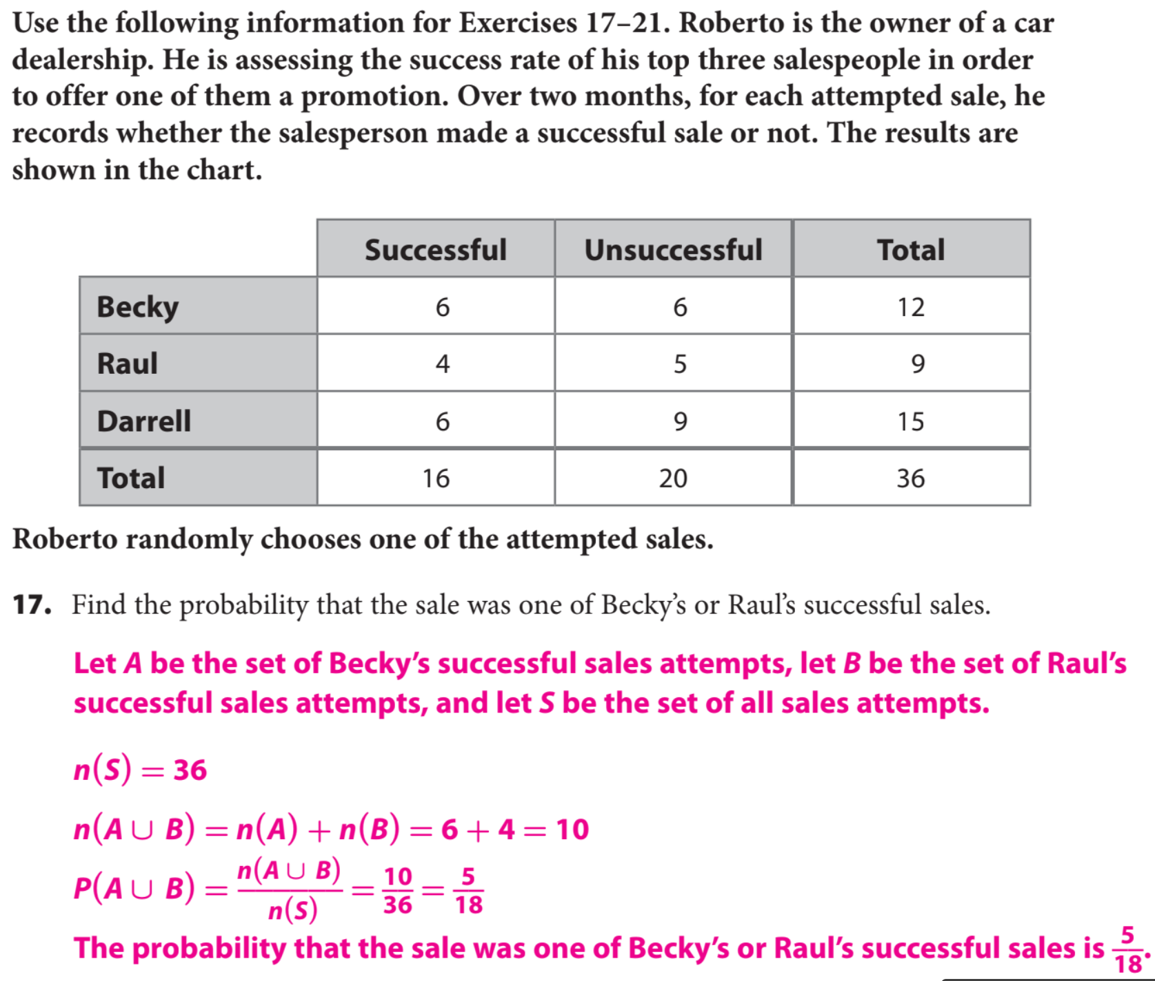
Homework

Slide 7
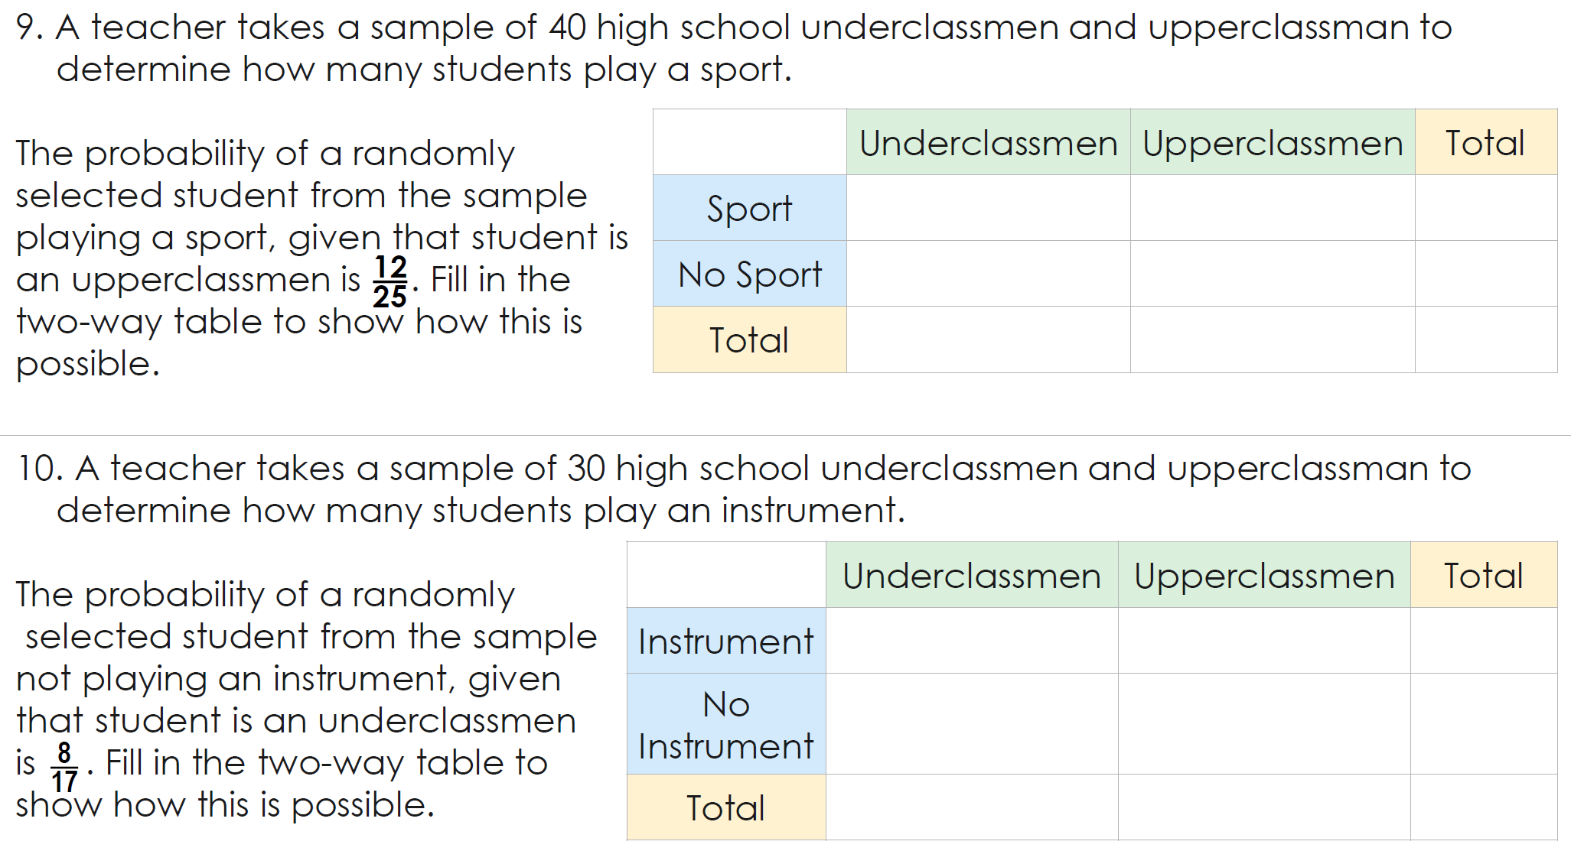
Homework
Word Bank
Mutually exclusive Event Intersection Diagram probability Overlapping union
What did you learn about the probability of events that are overlapping and mutually exclusive?
Summary Closer
Today, I learned how to _______________________________________ ____________________________________________________
_______________________________________________________________________________________________________.

