Slide 1
ACT RESPONSIBLY & SUPPORT the COMMUNITY.
Be on Time
Wear ID
Chromebook Ready
SEE SOMETHING, SAY SOMETHING

Slide 2
Students will learn how to write the probability of overlapping₁ events.
LEARNING OBJECTIVE
Definition
¹ Have an element in common.
Declare the Objective
Read the objective together with me.

Slide 3
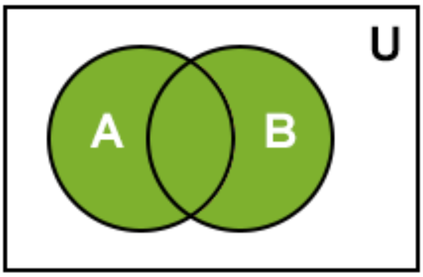
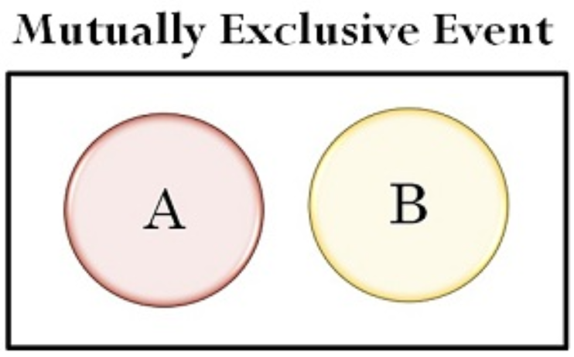
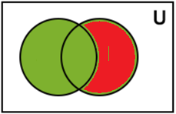
Remember the Concept
Two events are mutually exclusive if they have “nothing” in common.
Determine if mutually exclusive:
You rolled a number cube.
Event A: Roll an even number.
Event B: Roll an odd number.
1. Write the events using set notation.
Empty
$$U=\{1,2,3,4,5,6\}$$
$A=\{2,4,6\}$ and $B=\{1,3,5\}$
ACTIVATE PRIOR KNOWLEDGE
2. Draw a Venn Diagram
A
B
2,
4,
6
1,
3,
5
Make the Connection
Students, you already know how to determine if two events are mutually exclusive. Today, we will learn how find probabilities of Overlapping Events.
3. Determine if the two events are mutually exclusive
Since, event $A∩B=∅$. It’s not possible to roll a number that is both even AND odd at the same time, therefore the events are mutually exclusive.

Slide 4
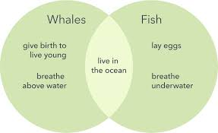
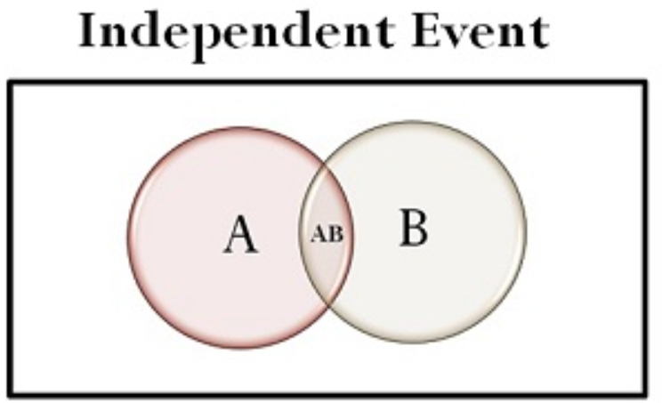
The process used in the mutually exclusive events can be generalized to give the following formula:
Remember the Concept
Intersection (AND): A ∩ B Each element is in both set A and set B. Find where the sets overlap. Union (OR): A ∪ B All elements in set A or set B. Join together all of the elements in both sets. Complement: $A^{C}$of a set A refers to all elements in the given universal set U that are not in A.
Recall Distributive Property:
Two events are overlapping events (or inclusive events) if they have one or more outcomes in common.
Overlapping Events
Concept Development
Remember the Concept
If the intersection is empty, the events are mutually exclusive.
If the intersection is NOT empty, the events are Overlapping (inclusive events).
Check For Understanding
Give example of overlapping events using outcomes from different probability experiments, such as: a spinner, a number cube, or a deck of cards.
Give an example of Mutually Exclusive events?

Slide 5
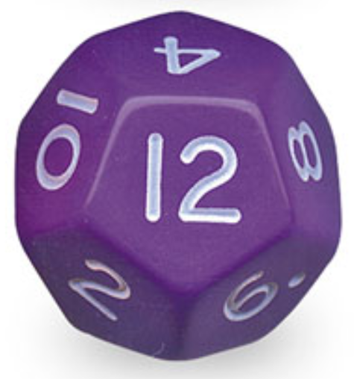
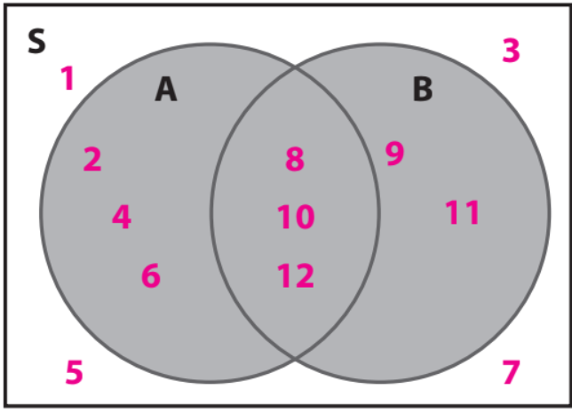
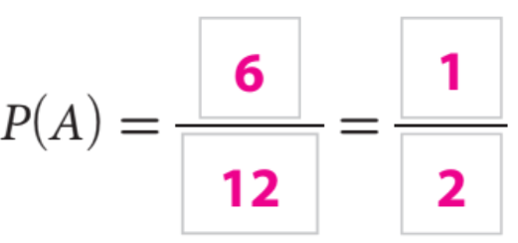
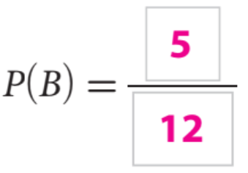
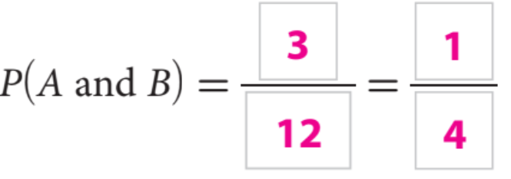
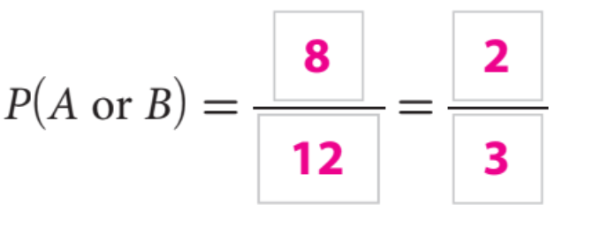
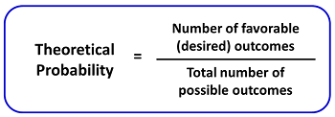
Find the Probability of Overlapping Events.
What is the probability that you roll a number dodecahedron cube and the result is an even number or a number greater than 7?
Steps
1. Define the events. “Write them in Set Notation.”
CFU How did you/I determine the event?
2. Draw a Venn Diagram.
CFU How did I/you draw a Venn Diagram?
3. Find P(A), P(B), P(A and B), and P(A or B).
CFU How did I/you find each probability?
4. Addition Rule.
CFU How did I/you I calculate the P(A or B)?
1. Write the events using set notation.
$$U=\{1,2,3,...11, 12\}$$
$A=\{2,4,6, 8, 10, 12\}$ and $B=\{8, 9, 10, 11, 12\}$
2. Draw a Venn Diagram
Check For Understanding
A: How is P(A or B) different from P(A and B)?
B: What is the Addition Rule states?
Skill Development
3. Find P(A), P(B), P(A and B), and P(A or B).
4. Addition Rule

Slide 6
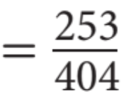
How do you find the probability of mutually exclusive events and overlapping events?
Overlapping Events
“Inclusive”
P(A or B) = P (A) + P (B).
P(A or B) = P(A) + P(B) - P(A and B).
Check For Understanding
A: What is Mutually Exclusive Event?
B: What is Inclusive Event?
Skill Development
Check For Understanding
A: How I find the P(senior or girl)?
B: What is a two-way table?
= 63%

Slide 7
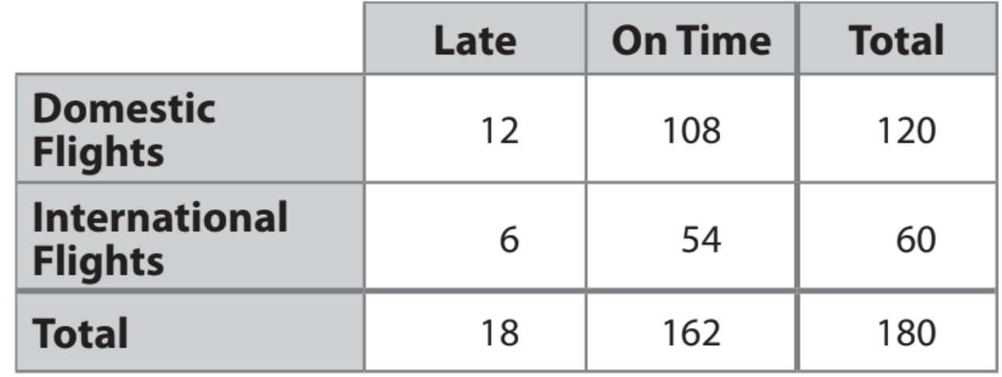
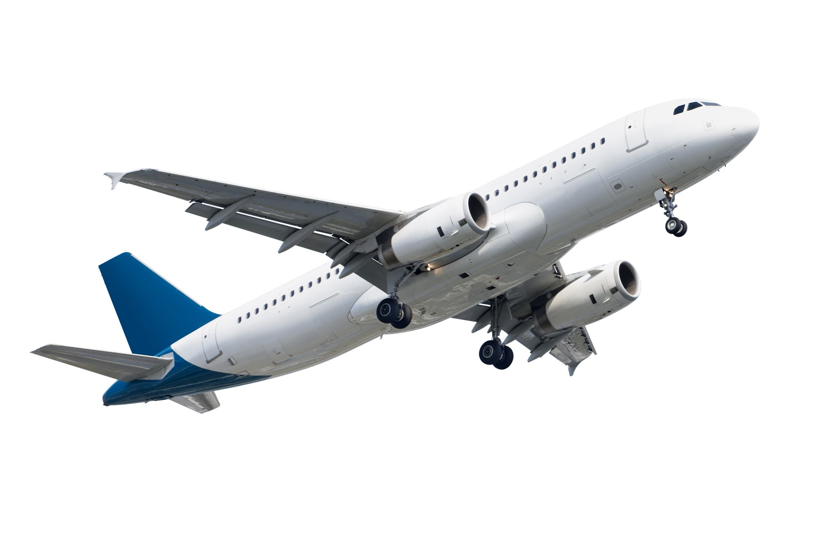
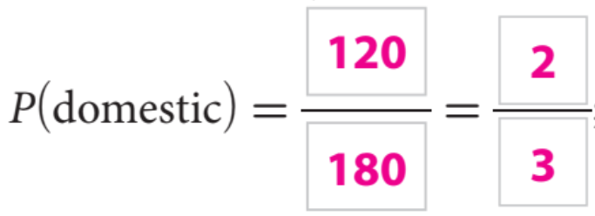
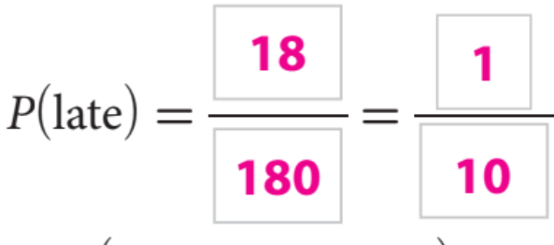
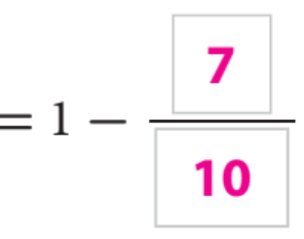
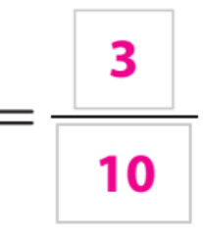
Complement: 1 - P
Skill Development

Slide 8
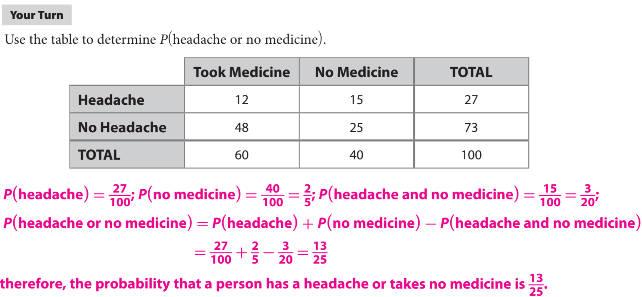
Essential Question Check-In: How do you determine the probability of Mutually Exclusive events and Overlapping events?
Homework

Slide 9
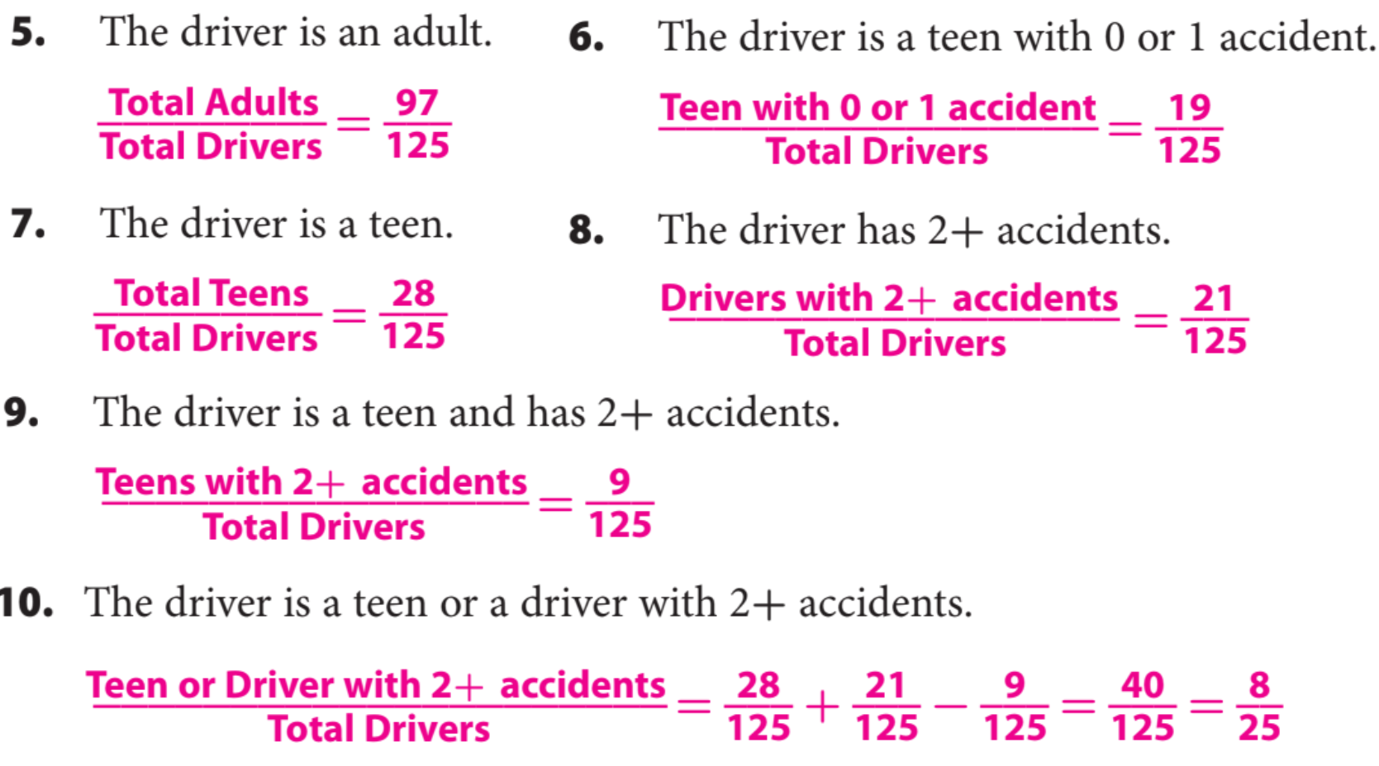
The table shows the data for car insurance quotes for 125 drivers made by an insurance company in one week.
Homework

Slide 10
Use the following information for Exercises 11–16. The table shown shows the results of a customer satisfaction survey for a cellular service provider, by location of the customer. In the survey, customers were asked whether they would recommend a plan with the provider to a friend.
One of the customers that was surveyed was chosen at random. Find the probability of each event.
Homework

Slide 11
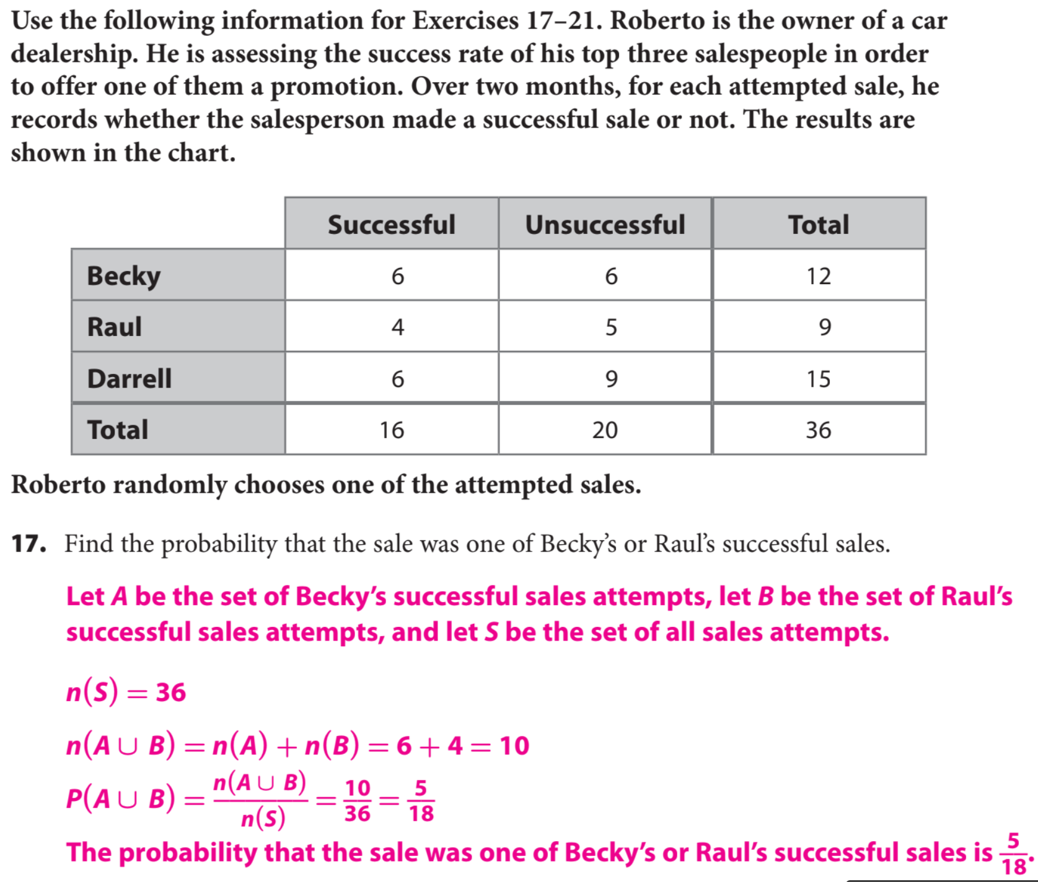
Homework

Slide 12
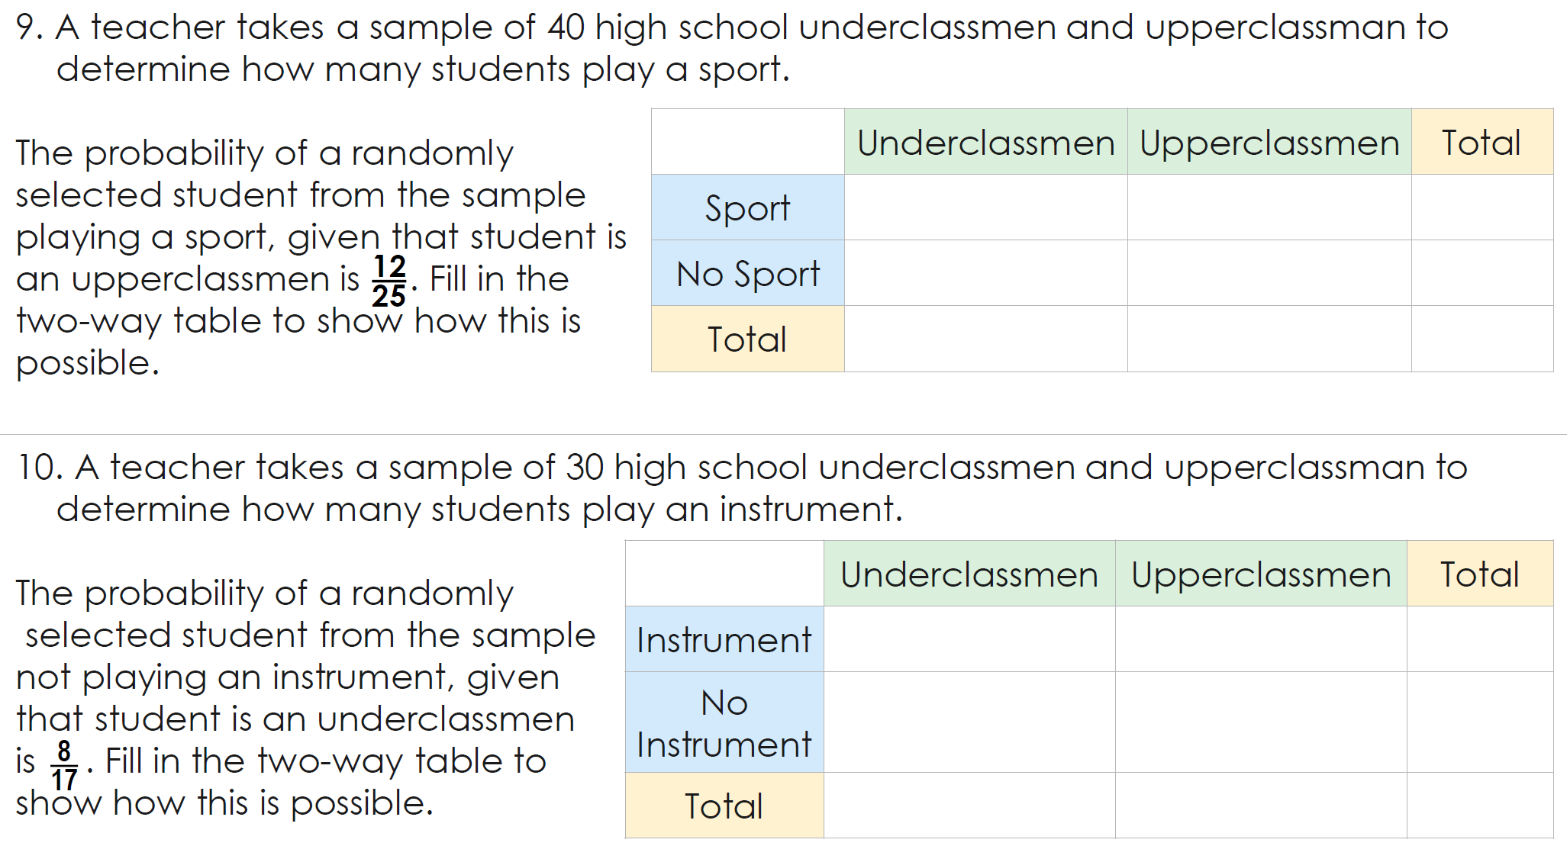
Homework

Slide 13
What did you learn about the probability of events that are overlapping and mutually exclusive?
Word Bank
Mutually exclusive Event Intersection Diagram probability Overlapping union
Summary Closer
Today, I learned how to _______________________________________ ____________________________________________________
_______________________________________________________________________________________________________.

