Slide 1
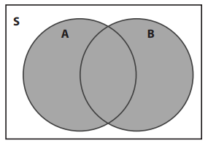
Lesson 4: 22.4 Mutually Exclusive Events
Name:__________________________
Period: _______
1. Consider $U=\{1, 2, 3, …,8, 9, 10\}$.
Say$A=\left\{1,3,5,7\right\} and B=\left\{2,4,6,8\right\}.$
Draw a Venn Diagram.
Find the set $A∩B$.
Remember the Concept
Draw a box for U and smaller circles for A and B.
ACTIVATE PRIOR KNOWLEDGE
Make the Connection
We know how to draw Venn diagrams. Now we will study what happens when two sets (circles) do not intersect (share any elements).
Two events are _________________ if they cannot both occur in the same trial of an experiment.
Trial: flip a coin. Events: A $≡$ it lands heads and B $≡$ it lands tails
Zero elements!
Notation:
$$A∩B=\{ \}$$
$$A∩B$$
Check For Understanding
How would you describe mutually exclusive events to another student in your own words? How could you use a Venn diagram to assist in your explanation?
Concept Development
Heads
Tails
A and B are _______________
If the intersection $A∩B$ is empty $∅$, then A and B are ______________.

Slide 2
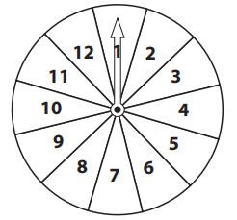
Determine if mutually exclusive or overlapping.
Example 1: Roll a number cube.
A is the event you roll an even number.
B is the event you roll an odd number.
1. $U=\{1,2,3,4,5,6\}$,
$A=\{2,4,6\}$ and $B=\{1,3,5\}$
2.
3. A and B are mutually exclusive because $A∩B=∅$.
It’s not possible to roll a number that is both even AND odd at the same time.
Steps
1 Write the events using set notation.
CFU How did I/you write the events?
2 Draw a venn diagram
CFU How did I/you make a venn diagram?
3 Determine if the two events are mutually exclusive
CFU How did I/you determine if they’re mutually exclusive?
2, 4,
6
1, 3,
5
Skill Development
Example 2: You spin a spinner with 12 equal sections.
Is the event that it lands on a prime number mutually exclusive with the event that it lands on a multiple of 4?
1. $U=\{1,2,3,…, 10,11,12\}$,
$A=\{ \}$ and $B=\{ \}$
2.
3. A and B are ___________because it’s not possible to roll a number that is both prime AND multiple of 4 at the same time.
Remember the Concept
If the intersection is empty, the events are ____________________.
If not mutually exclusive, it’s because they are ____________________

Slide 3
Determine if mutually exclusive or overlapping
Steps
1. Write the events using set notation.
CFU How did I/you write the events?
2. Draw a venn diagram
CFU How did I/you make a venn diagram?
3. Determine if the two events are mutually exclusive
CFU How did I/you determine if they’re mutually exclusive?
Example 3: You spin a spinner with 12 equal sections.
Is the event that it lands on an even number mutually exclusive with the event that it lands on a multiple of 4?
1. $U=\{1,2,3,…, 10,11,12\}$,
$A=\{ \}$ and $B=\{ \}$
2.
3. A and B are not ______________ because they overlap. The numbers 4, 8, and 12 are both even and multiples of 4.
Skill Development
Remember the Concept
If the intersection is empty, the events are ____________________.
If not mutually exclusive, it’s because they are ____________________
What did you learn about events that are mutually exclusive?
Word Bank
Mutually exclusive Event Intersection Diagram
Skill Development
Today, I learned how to _________________________________________________________________________________.

