Slide 1
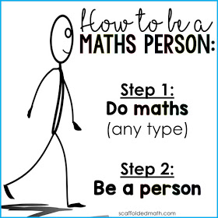
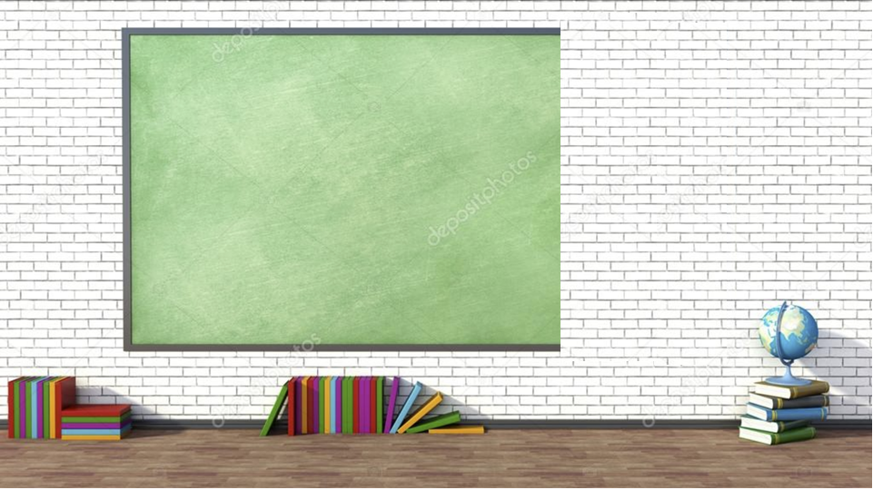
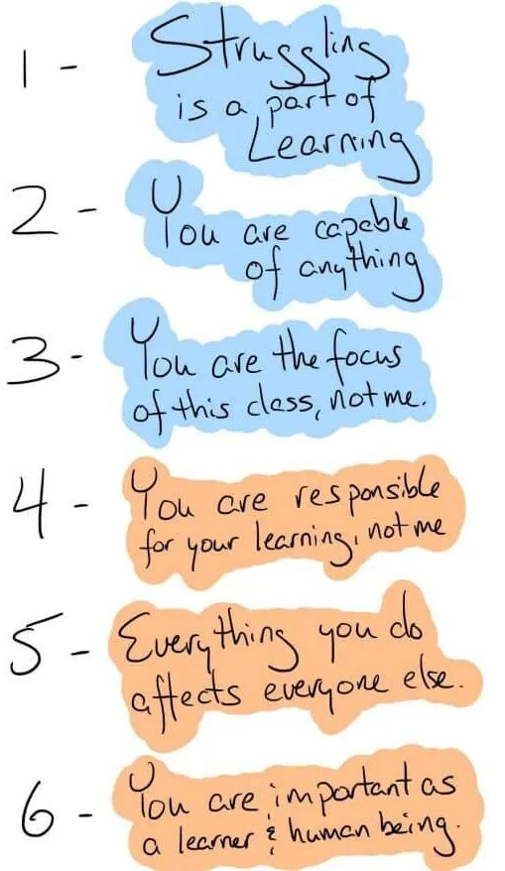
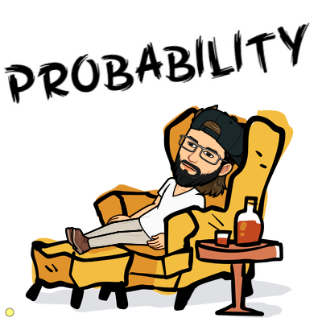
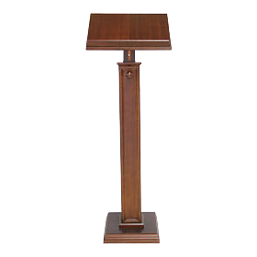
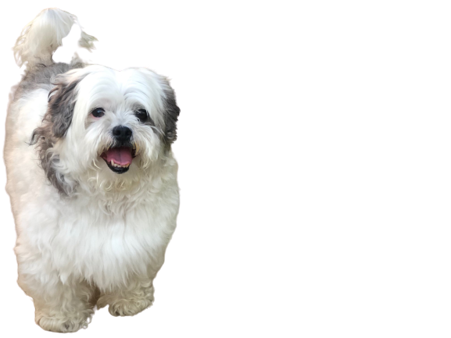
9/14/2020
Today’s Learning Target: Students will practice on how to use the Complement of an Event to
calculate the probability.
Purpose of Target: ...so we can successfully solve the homework problems on my.hrw.com.
Success Criteria: ... we are successful when everyone completes their my.hrw.com homework
assignment by the end of the day today.
Notes:
day day

Slide 2
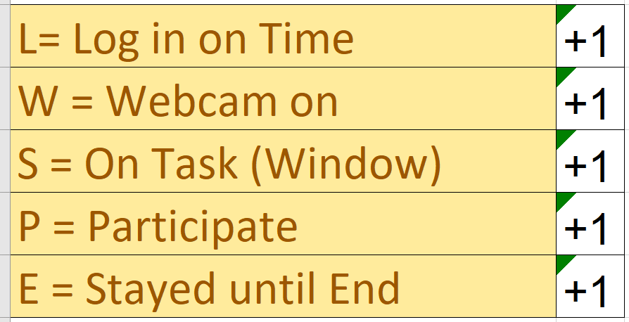
Period-1
Do Flashcard Assignment | Work with Mr. Jagpal
Acosta, Emily R. | Aguinaga Miranda, Amy
Bahena Martinez, Yuridia | Buenrostro, Marisol M.
Chico, Omar | Gonzalez, Daryll
Muniz, Jorge A. | Guzman, Matthew M.
Gonzalez, Alondra | Heredia, Sammy
Garcia, Daniel | Hernandez, Willie A.
Wagoner, Zoe R. | Macias, Brian
 | Martinez, Janell D.
 | Millan, Marcos
 | Olivares, Javier A.
 | Parra Maldonado, Juan
 | Ramirez, Jannessa A.
 | Santos Jimenez, Maximiliano
 | Talley, Xander M.
 | Tello, Crystal
Period-4
Do Flashcard Assignment | Work with Mr. Jagpal
Fernandez, Mayra | Carranza, Ashley J.
Gonzalez, Natalie | Sanchez, Jazmein M.
Kaur, Amritjot | Aguilar, Esbeide Teresa
Mendez, Casandra | Ambriz, Arnulfo I.
Piza Serrano, Keilly Monserrath | Arroyo, Andrea
Diaz, Yasmin L. | Bermudez, Maritsa
Esquivias, Enrique A. | Cardenas, Zachary J.
Orosco, Lizeth | Chavez, Briseida E.
Cervantes Cruz, Joel L. | Estrada, Angel G.
 | Fuentes, Rey Josue
 | Jimenez, Yamila O.
 | Lopez, Alan J.
 | Pantoja, Amadeus R.
 | Pulido, Mariano A.
 | Singh, Jasvir
 | Terrill, Destiny A.
 | Vivas, Crystal
 | Zamora Arceo, Evelyn
Period-5
Do Flashcard Assignment | Work with Mr. Jagpal (my.hrw.com)
Diaz, Yuleisy | Aguilar, Marianyeli L.
Mendoza, Genesis A. | Alvizo, Saeed
Cantellano, Sashenka | Fuentes, Alexis
Chahal, Jovinjeet K. | Gutierrez, Chloe I.
Pulido, Aurora C. | La Blue, Klub
Rocha, Alani M. | Maldonado, Joel E.
Loza, Stephanie | Pimentel, Giselle
Munoz, Salvador | Soto Espinoza, Monserrat
Cruz, Liset A. | Tapia, Esmeralda B.
Valencia, Lisset R. | Vargas Aguilar, Brisehida
 | Villafan Padilla, Angel R.
Period-3
Do Flashcard Assignment | Work with Mr. Jagpal
Jaimes, Jasmin | Maldonado, Evelyn
Sanchez, Jesus | Aguilar, Mark A.
Jimenez, Rubi P. | Avila, Miranda A.
Pimentel, America I. | Berrocal, Kenyi A.
Galan, Ernesto D. | Bishop, Kaylee M.
Nieto, Derek J. | Cortez Soto, Angel S.
Ramirez, Angel J. | Flores, Giselle
Salgado, Melanie | Flores, Jahidi A.
Castorena, Giovanni J. | Gallegos, Sharai
Servin, Cesar | Gomez, Angel A.
Mendoza Novoa, Sandra N. | Leal LaBlue, Izzak A.
Quiroz Maria, Kimberly A. | Mendez Melgoza, Marco Sebastian
 | Ochoa, Victoria B.
 | Pedro, Hugo M.
 | Rodriguez Baena, Julio Cesar
 | Sanchez Rodriguez, Perla Soraya
 | Torres Orejel, Brenda D.
 | Villa, Ana Carla
Any tech issues, you must email me and the librarian, Else its ZERO.
Differentiate
Period-7
Do Flashcard Assignment | Work with Mr. Jagpal
Casey, Kearsin M. | Calderon, Isaiah J.
Garcia, Marcos A. | Ceja Garcia, Jacqueline E.
Prine Wilber, Steven S. | Chavez, Aaliyah T.
Martinez, Vada | Duran, Emely
Morales, Sondra B. | Garcia, Emanuel
Orosco, Gissell | Gonzalez, John M.
Robles, Rodrigo | Gonzalez Torres, Jose Luis
Alvarez, Nancy M. | Johal, Manvir S.
Cervantes, Maria del Rosario | Marmolejo, Missael
Cervantes, Nancy | Ramirez, Juan C.
Sandoval, Emily M. | Venegas Colmenares, Ashanti P.
Cruz, Marissa D.
Maldonado, Santiago
Ruiz, Princess A.
Her, Grace N.
“Flashcard Assignment”

Slide 3
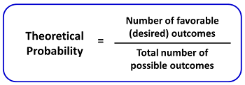

Slide 4
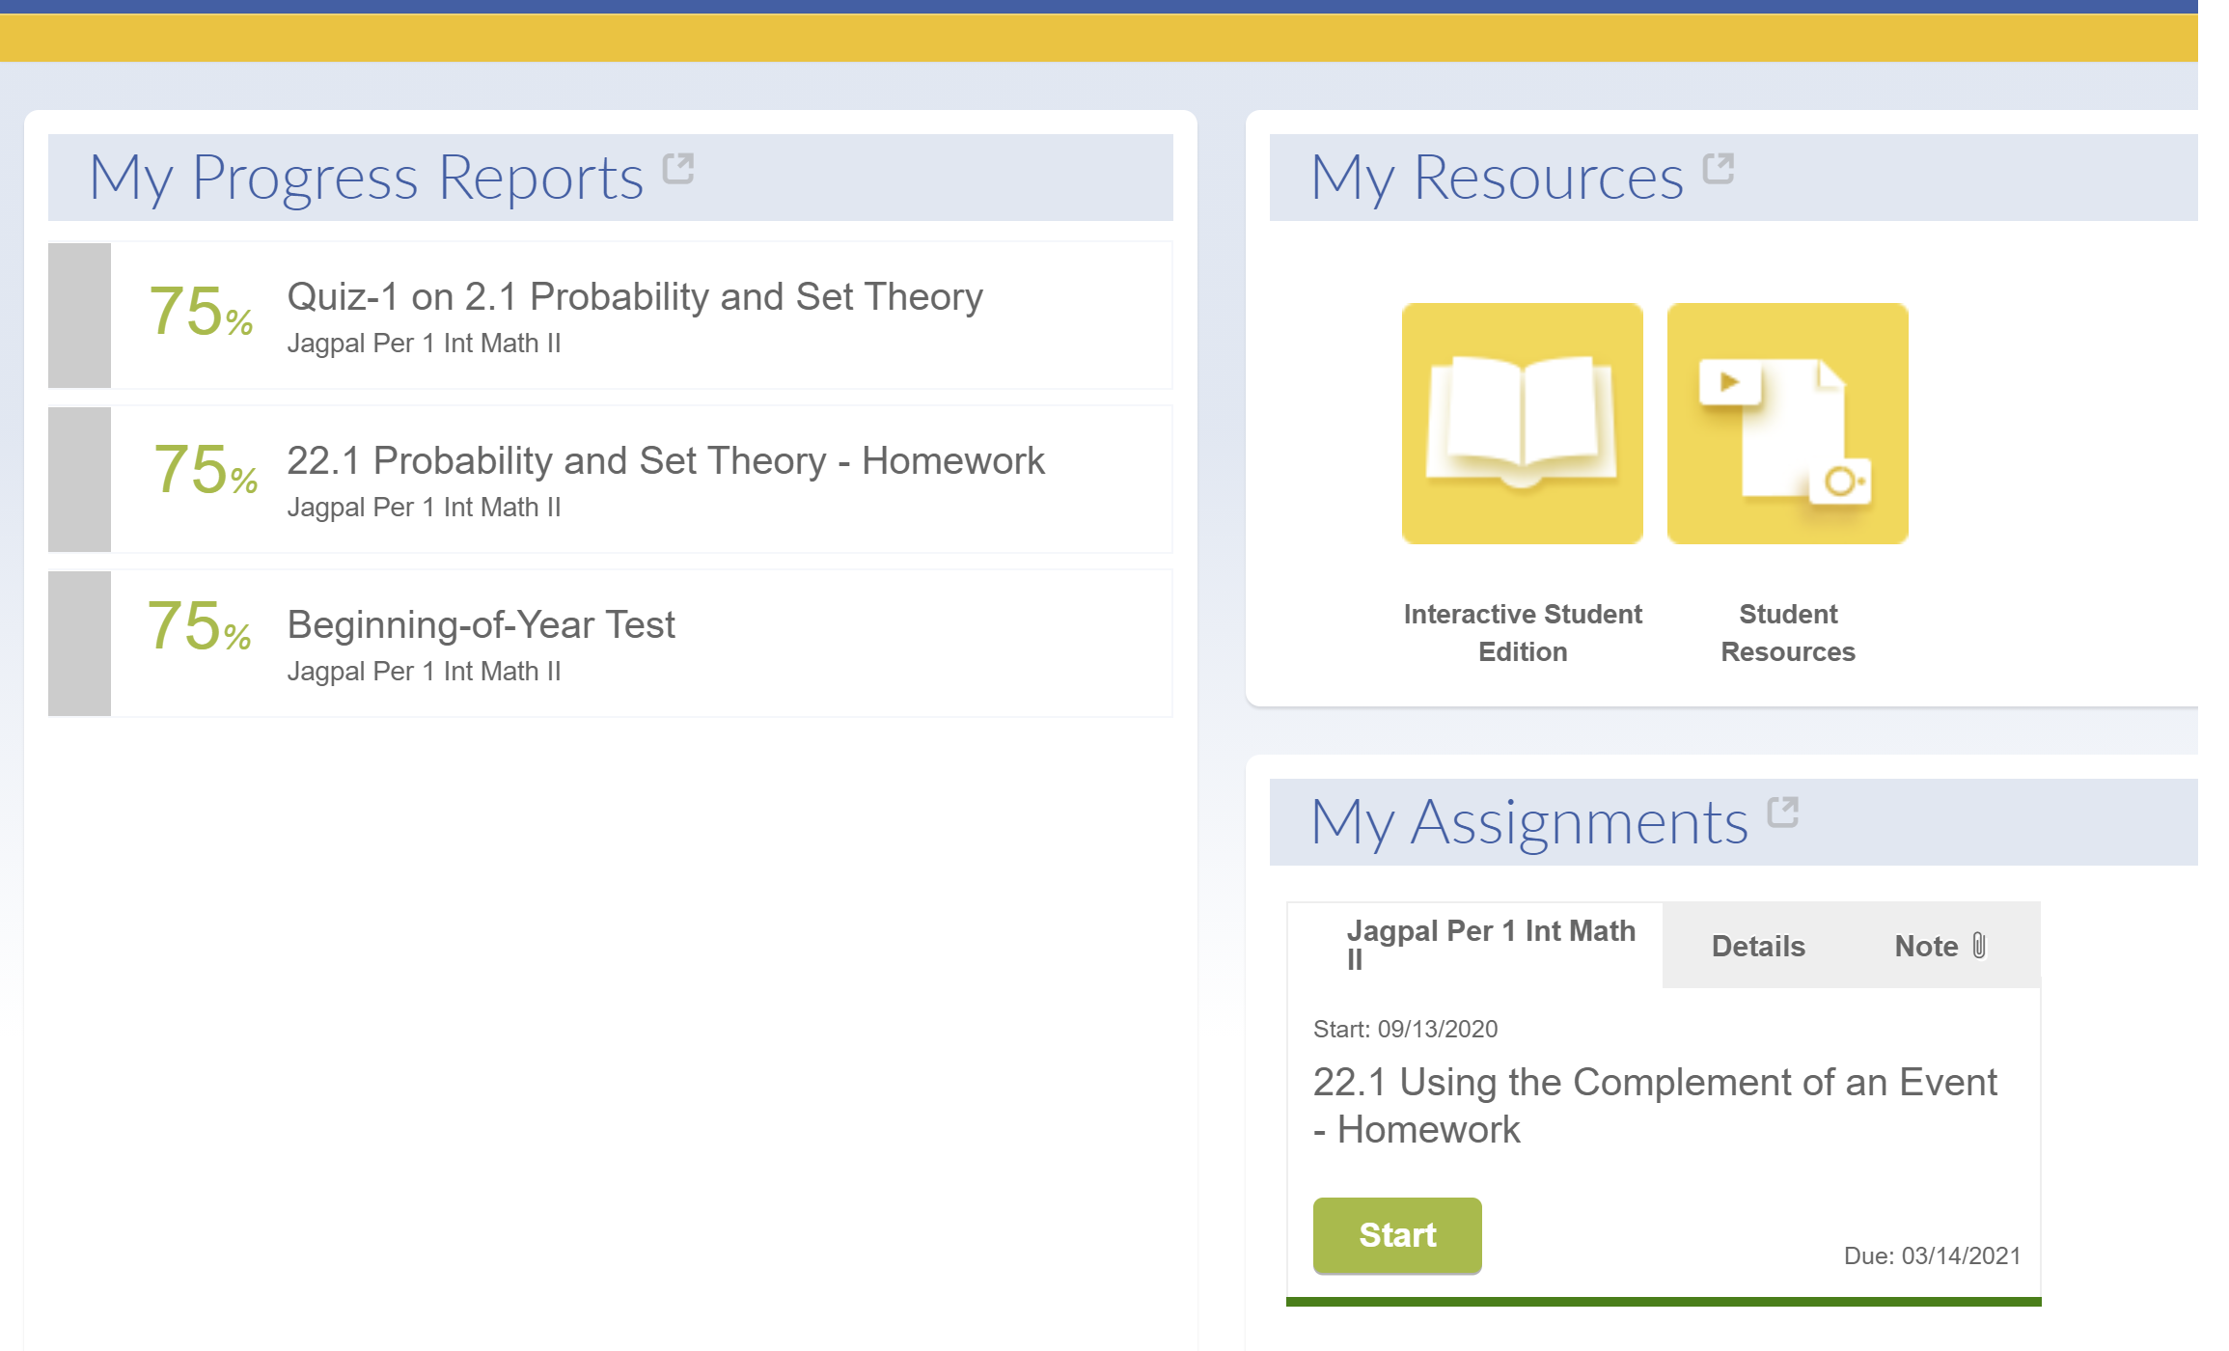
}
If you complete any missing assignments, email me to added it to your Grade.
Do your assignment as I go over the questions. Don't be in passive mode. I will post these notes on the Google Classroom.
Past due now!!

Slide 5
1.

Slide 6
2.
36
Add cross (18 + 18)
16
Add cross (8 + 8)
26
26
52
Add down (18 + 8)
Divide 18 by 26
$$\frac{9}{13}$$
$$\frac{1}{2}$$
Divide 26 by 52

Slide 7
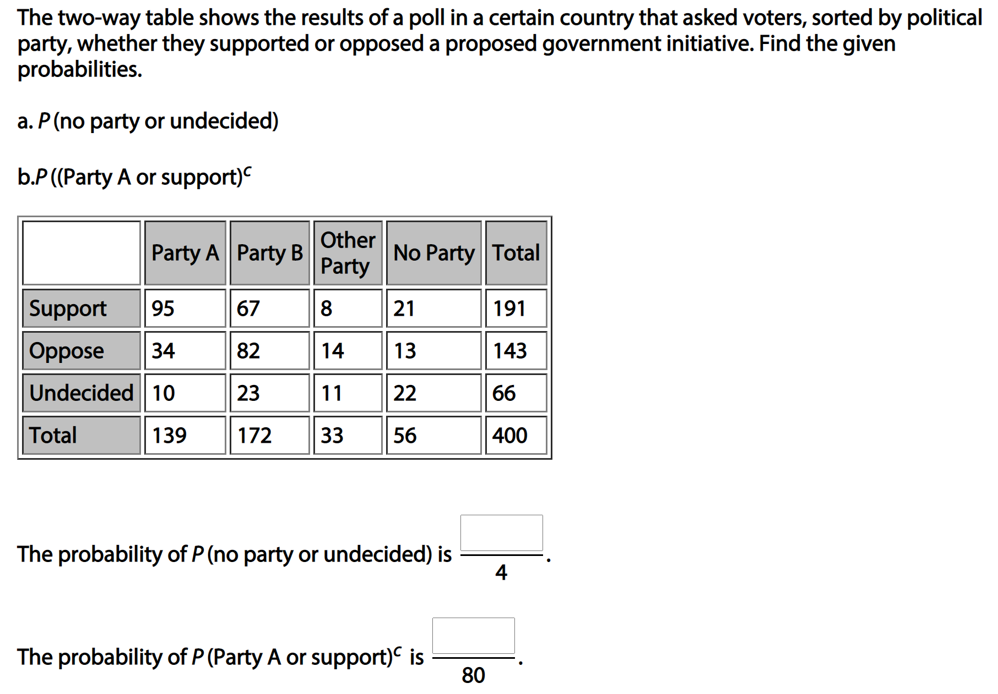
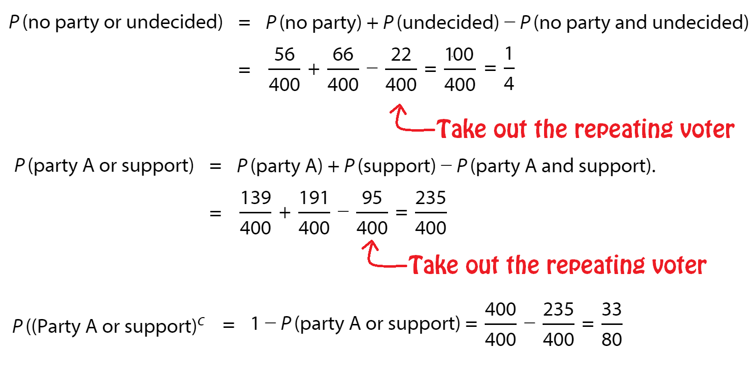
3.
1
*Must reduce the fraction to Lowest Terms
33
*Must reduce the fraction to Lowest Terms

Slide 8
4.
$$\frac{5}{6}$$

Slide 9
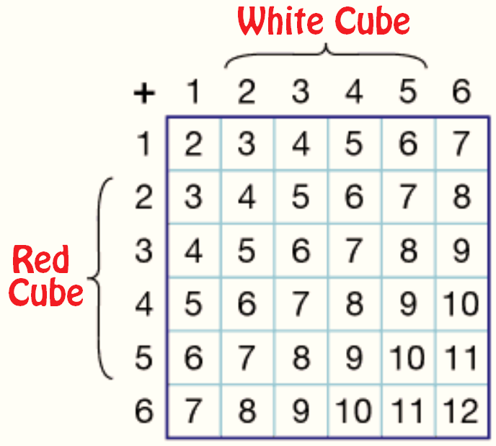
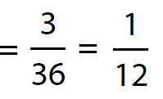
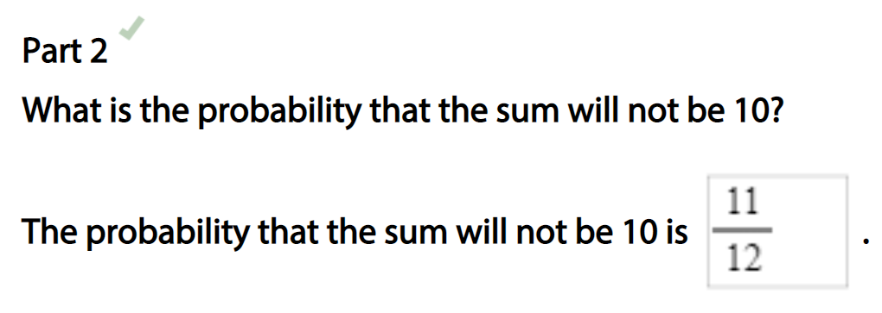
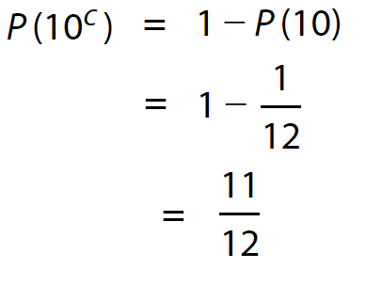
5.
*Must reduce the fraction to Lowest Terms

Slide 10
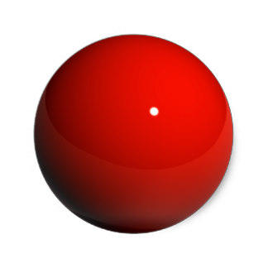
6.
1.
2.

Slide 11
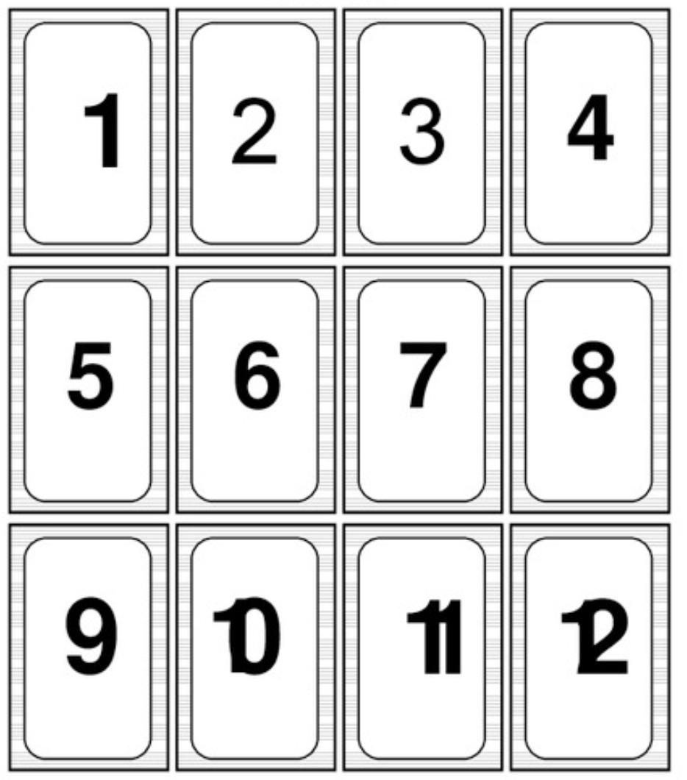
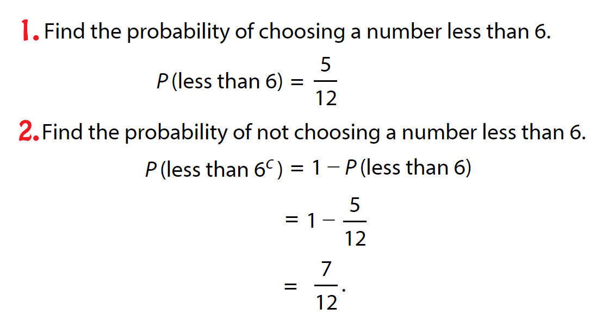
7.

Slide 12
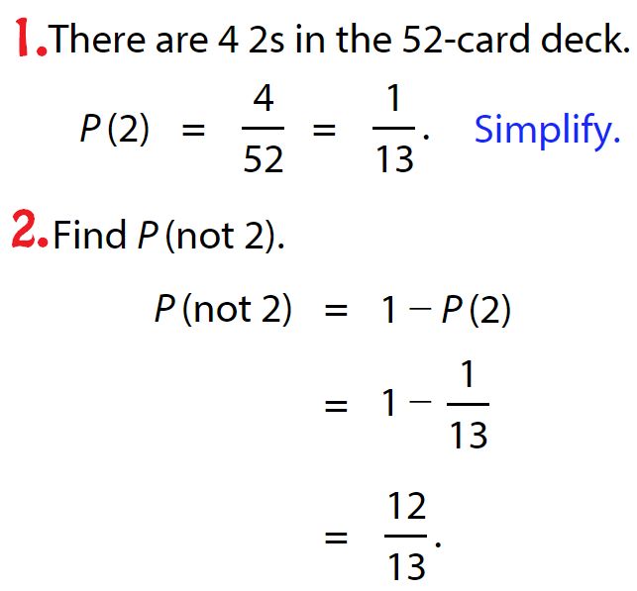
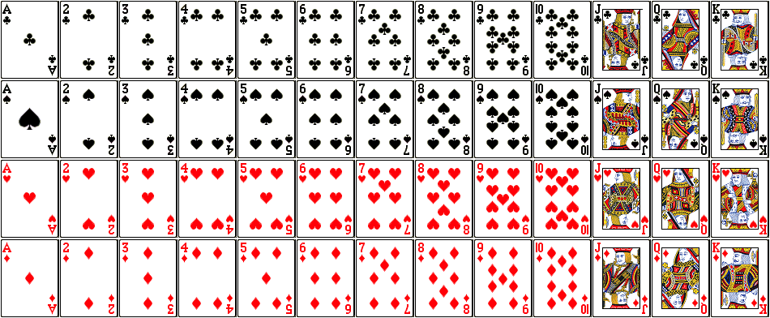
8.

Slide 13
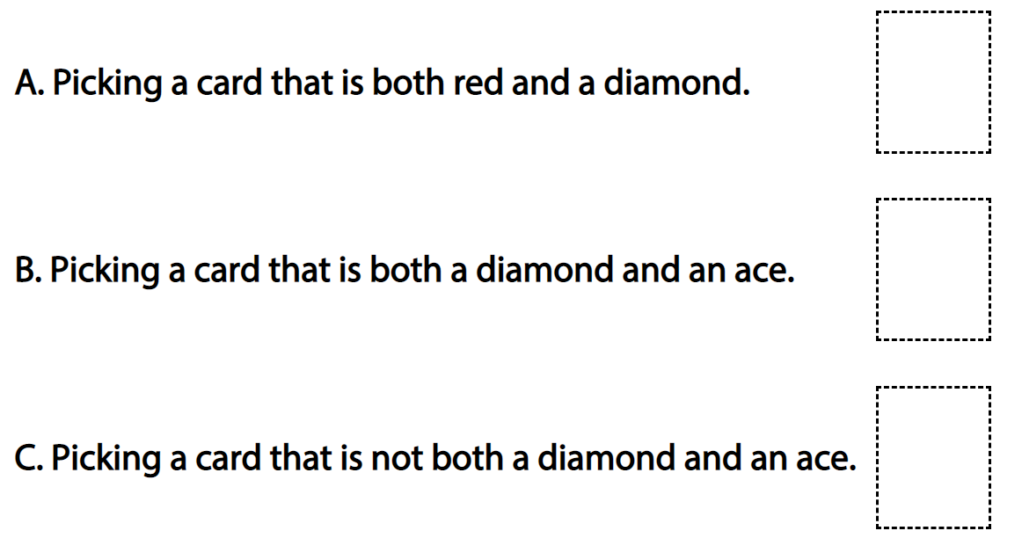
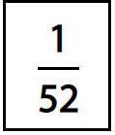
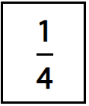
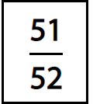
9.

Slide 14
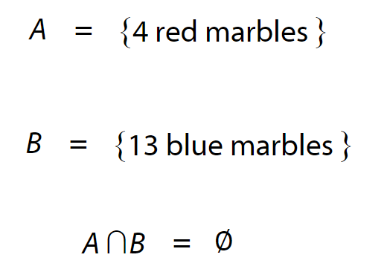
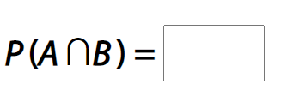
10.
$$0$$

