Slide 1
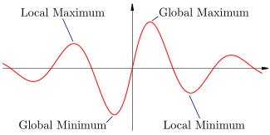
L.O: Students will learn how to determine the Characteristics of Function Graphs and take detailed notes in their notebook.
Key Features of graphs
Domain (X-value) & Range (Y-Value)
X-Intercepts (x, 0) and Y-Intercepts (0, y)
Increasing/Decreasing
Extrema (Minimum/Maximum)
Rate of Change (Slope)
Back

Slide 2
Turning points: - Change from increasing to decreasing or from decreasing to increasing
Minimum (Low Point):- Changes from decreasing to increasing
Maximum (High Point or peak):-Changes from increasing to decreasing
Back

Slide 3
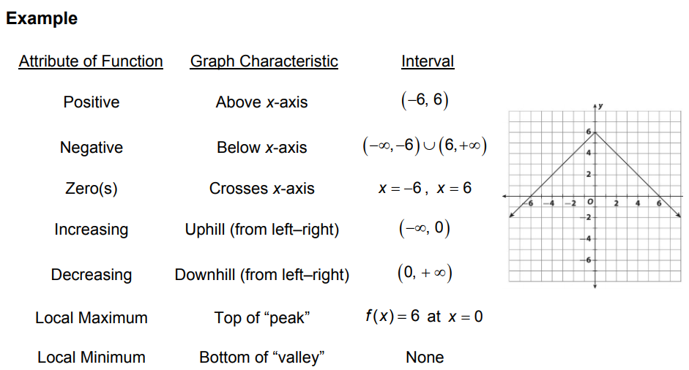

Slide 6
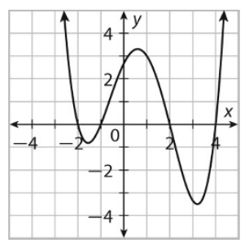
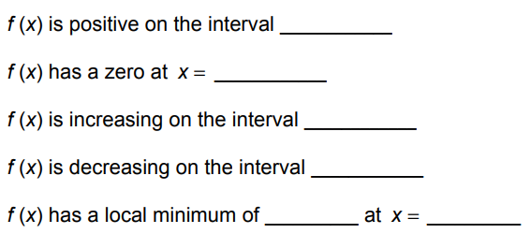
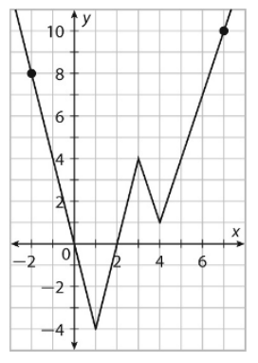

Slide 8
