Slide 1
IMPOSTER MATH!
math talk warm up
You will try to figure out which one does not belong (is the “imposter”) on each slide! Drag the Imposter over and if you want to answer, you will have to explain WHY. You will type it if you are doing this independently or tell it vocally during a class activity! Some slides have more than one answer!
Notes:
Curated from: https://linktr.ee/teachers.tea

Slide 2
Teachers:
This resource was created to use it as a math talk warm up (full class). It is powerful to have math conversations with students and discuss the WHY. Some of the pages have more than one answer possible so it is important to let the students explain WHY they choose their answer.
Watch the Video
Notes:
https://stevewyborney.com/2015/02/math-imposter-sets-with-video-and-pdf/

Slide 3
2 + 3
6 + 6
Why do you think that one is the imposter?
3 + 3
9 + 9

Slide 4
1 x 6
6 x 1
Why do you think that one is the imposter?
6 + 0
6 x 0

Slide 5
3 + 2 - 1
1 + 2 - 3
Why do you think that one is the imposter?
5 - 5 + 0
10 - 7 - 3

Slide 6
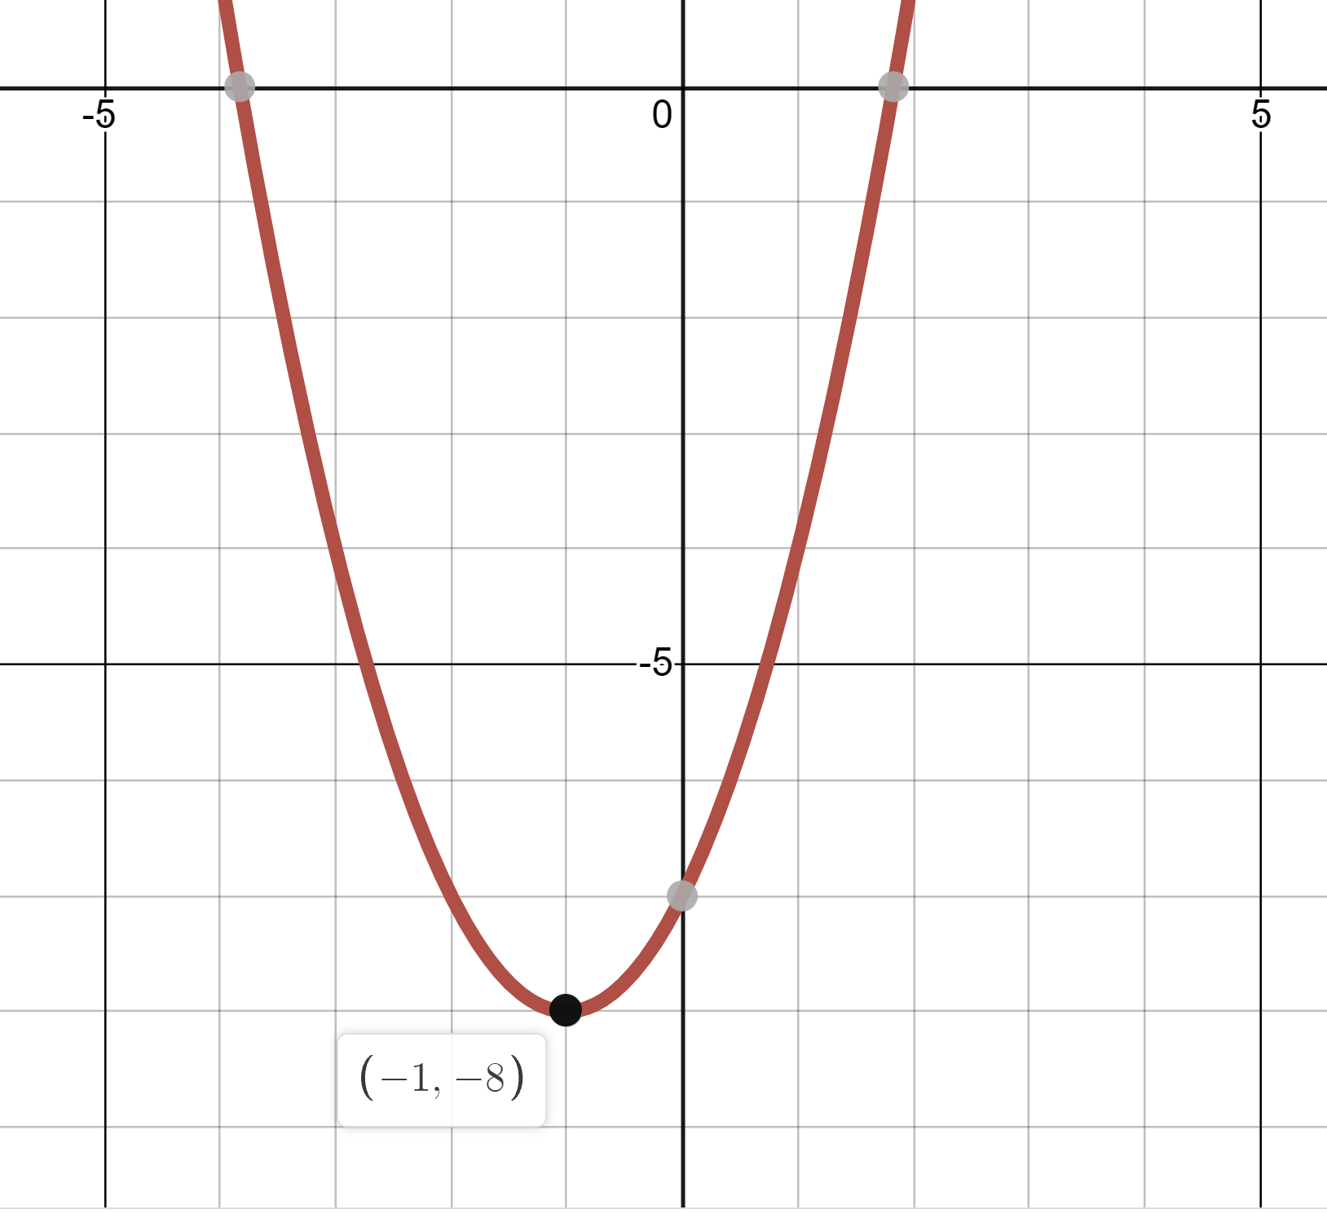
F(x) = 2$x^{2}−4x−6$
F(x) = $\frac{8}{9}\left(x+2\right)(x−4)$
Why do you think that one is the imposter?
The Vertex
F(x) = -$({x−1)}^{2}−8$

