Slide 1
Objective: The students will learn how to find the y-intercept of a equation using the slope-intercept form. Students will demonstrate their understanding by achieving an accuracy rate of 70% or higher on Quiz-7 by the end of class.
Math Notebook
CFU: What are we going to learn TODAY?

Slide 2
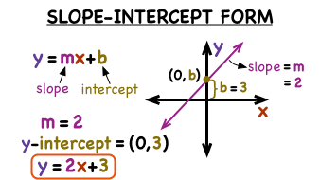

Slide 3
Skill Development & Guided Practice 4
Determine the slope and y-intercept of an equation in slope-intercept form.
Checking for Understanding
1 Find the slope (m) (use the formula).
2 Determine the y-intercept (0, #).
3 Substitute the slope and y-intercept into y=mx + b to obtain the equation of the line.
2 How did I/you determine the y-intercept?
3 How did I/you obtain the equation?
1. Write the equation of the line through (0, -2) and (3, 5).
$$x1$$
$$y1$$
$$x2$$
$$y2$$
$$y2  y1$$
5 − (-2)
7
$m$ =
$$x2  x1$$
=
=
3
3 − 0
$b$ = -2
Slope Formula
$m$ =
$y$ = $\frac{7}{3}$ $x$ – 2
y₂ – y₁
x₂ – x₁
2. Write the equation of the line through (4, -7) and (0, 1).
$$x1$$
$$y1$$
$$x2$$
$$y2$$
y-intercept
y = mx + b
y₂ − y₁
1 − (-7)
8
2
$m$ =
x₂ − x₁
=
=
-4
= -
0 − 4
1
slope
$b$ = 1
$y$ = - $\frac{2}{1}$ $x$ + 1
151

Slide 4
Skill Development & Guided Practice 4 (continued)
Determine the slope and y-intercept of an equation in slope-intercept form.
Checking for Understanding
1 Find the slope (use the formula).
2 Determine the y-intercept (b).
a Solve for b.
b Substitute the slope for m and one of the points for x and y in the slope intercept formula.
3 Substitute the slope(m) and y-intercept(b) into y=mx + b to obtain the equation of the line.
2b How did I/you solve for b?
2a How did I/you obtain the y-intercept?
2a. Solve for b: y = mx + b.
y = mx + b
Slope Formula
$m$ =
y₂ – y₁
-mx
-mx
x₂ – x₁
y - mx b
y-intercept
y = mx + b
slope
So, therefore b = y – mx.
Point: (x, y)
Slope (m)
151

Slide 5
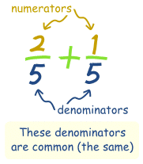
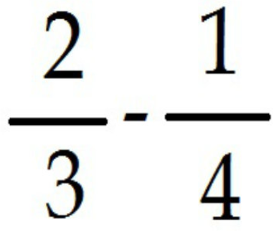
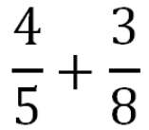
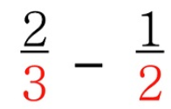

Slide 6
Skill Development & Guided Practice 4 (continued)
Determine the slope and y-intercept of an equation in slope-intercept form.
Checking for Understanding
1 Find the slope (use the formula).
2 Determine the y-intercept (b).
a Solve for b.
b Substitute the slope for m and one of the points for x and y in the slope intercept formula.
3 Substitute the slope(m) and y-intercept(b) into y=mx + b to obtain the equation of the line.
2 How did I/you determine the y-intercept?
3 How did I/you obtain the equation?
b = y – mx
Write the equation of the line through (-3, 5) and (6, 2).
y₁
y₂
x₁
x₂
y₂ − y₁
2 − 5
-3
1
m =
=
=
= -
Slope Formula
$m$ =
x₂ − x₁
6 − (-3)
9
3
y₂ – y₁
x₂ – x₁
-1
b = y – mx = 5 – ( ) (-3).
3
y-intercept
=
y = mx + b
slope
= 4
So, y = - $\frac{1}{3}$ x + 4
You Try! Write the equation of the line through (-2, -3) and (-3, -4).
151

Slide 7
Skill Development & Guided Practice 4 (continued)
Determine the slope and y-intercept of an equation in slope-intercept form.
Checking for Understanding
1 Find the slope (use the formula).
2 Determine the y-intercept (b).
a Solve for b.
b Substitute the slope for m and one of the points for x and y in the slope intercept formula.
3 Substitute the slope(m) and y-intercept(b) into y=mx + b to obtain the equation of the line.
2 How did I/you determine the y-intercept?
3 How did I/you obtain the equation?
b = y – mx
You Try! Write the equation of the line through (-2, -3) and (-3, -4).
Slope Formula
$m$ =
y₂ – y₁
x₂ – x₁
y-intercept
y = mx + b
slope
151

Slide 8
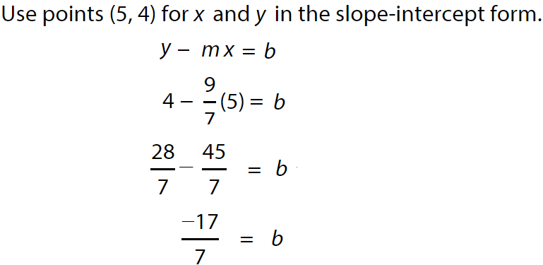
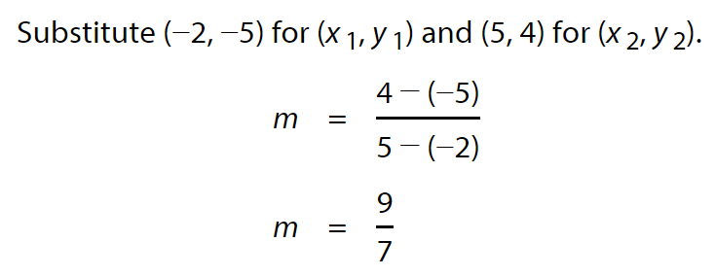
Skill Development & Guided Practice 4 (continued)
Determine the slope and y-intercept of an equation in slope-intercept form.
Checking for Understanding
1 Find the slope (use the formula).
2 Determine the y-intercept (b).
a Solve for b.
b Substitute the slope for m and one of the points for x and y in the slope intercept formula.
3 Substitute the slope(m) and y-intercept(b) into y=mx + b to obtain the equation of the line.
2 How did I/you determine the y-intercept?
3 How did I/you obtain the equation?
b = y – mx
Write the equation of a line that
passes through (−2, −5) and (5, 4).
Slope Formula
$m$ =
y₂ – y₁
x₂ – x₁
y-intercept
y = mx + b
slope

Slide 9
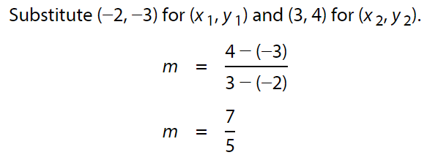
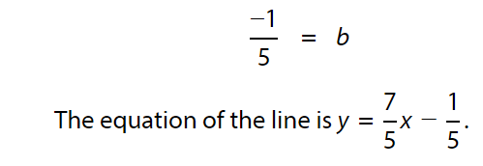
Skill Development & Guided Practice 4 (continued)
Determine the slope and y-intercept of an equation in slope-intercept form.
Checking for Understanding
1 Find the slope (use the formula).
2 Determine the y-intercept (b).
a Solve for b.
b Substitute the slope for m and one of the points for x and y in the slope intercept formula.
3 Substitute the slope(m) and y-intercept(b) into y=mx + b to obtain the equation of the line.
2 How did I/you determine the y-intercept?
3 How did I/you obtain the equation?
b = y – mx
Write the equation of a line that
passes through (−2, −3) and (3, 4)
Slope Formula
$m$ =
y₂ – y₁
x₂ – x₁
y-intercept
y = mx + b
slope

Slide 10
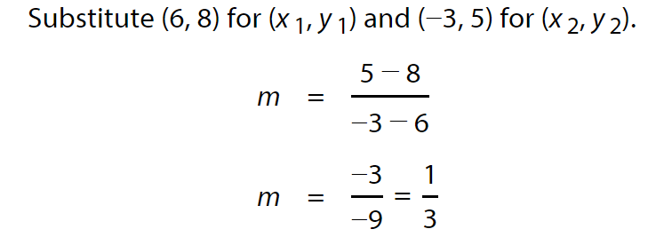
Skill Development & Guided Practice 4 (continued)
Determine the slope and y-intercept of an equation in slope-intercept form.
Checking for Understanding
1 Find the slope (use the formula).
2 Determine the y-intercept (b).
a Solve for b.
b Substitute the slope for m and one of the points for x and y in the slope intercept formula.
3 Substitute the slope(m) and y-intercept(b) into y=mx + b to obtain the equation of the line.
2 How did I/you determine the y-intercept?
3 How did I/you obtain the equation?
b = y – mx
Write the equation of a line that
passes through (6, 8) and (−3, 5).
Slope Formula
$m$ =
y₂ – y₁
x₂ – x₁
y-intercept
y = mx + b
slope

Slide 11
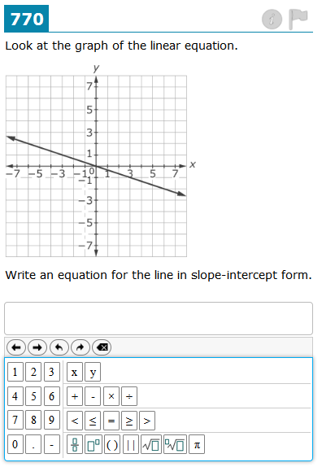
Relevance
1
Determining the equation of a line will help CG modelers animate character motion.
CG modelers animate the motion of cartoon characters in lines and curves.
When Elsa freezes Anna, the ice moves along the line y = 4x + 2.
Checking for Understanding
Which reason is most relevant to you?
2
Determining the equation of a line will help you do well on tests.
Sample Test Question
152

Slide 12
Closure
Skill Closure Determine the equation of a line using slope-intercept form.
y
2. Write the equation of the line through (-2, 6) and (0, -8).
1.
5
4
x₂
y₁
y₂
3
x₁
2
2
y₂ − y₁
-8 − 6
-14
7
1
m = $\frac{3}{2}$
m =
=
=
= -
Slope:
x₂ − x₁
0 − (-2)
2
1
⁻5
⁻4
⁻3
⁻2
3
x
⁻1
1
2
3
4
5
⁻1
(0, -2)
y-intercept:
b = -2
b = -8
⁻2
⁻3
y = $\frac{3}{2}$ x – 2
⁻4
Equation:
y = - $\frac{7}{1}$ x – 8
⁻5
Extended Thinking
Peter says the equation of the line through (0, 9) and (2, 3) is y = 3x + 9. Is he correct? Explain why or why not.
y₂ − y₁
3 − 9
-6
3
m =
=
=
= -
x₂ − x₁
2
1
Peter is incorrect. The slope is:
The y-intercept is 9. So the equation of the line is y = -3x +9.
Remember the Concept
2 − 0
A line can be described by the equation y = mx + b.
The slope of a line (m) is the ratio of the change in y to the change in x.
The y-intercept (b) is the point at which the line passes through the y-axis.
Summary Closure What did you learn today about determining the equation of a line? (Pair-Share)
Use words from the word bank.
Word Bank
slope y-intercept line equation graph
153

Slide 13
Independent Practice
Determine the slope and y-intercept of an equation in slope-intercept form.
Declare the Objective
1 Find the slope (from graph or formula).
2 Determine the y-intercept.
3 Substitute the slope and y-intercept into y=mx+b to obtain the equation of the line.
Read the learning objective to your partner.
1.
2.
y
y
5
5
2
4
4
(0, 3)
3
3
m = $\frac{5}{2}$
m = - $\frac{6}{1}$
5
2
Slope:
2
Slope:
1
1
x
b = 3
x
b = -4
⁻5
⁻4
⁻3
⁻2
⁻1
1
2
3
4
5
y-intercept:
⁻5
⁻4
⁻3
⁻2
⁻1
1
2
3
4
5
y-intercept:
⁻1
-6
⁻1
⁻2
Equation:
y = $\frac{5}{2}$ x + 3
⁻2
Equation:
y = - $\frac{6}{1}$ x – 4
⁻3
⁻3
(0, -4)
⁻4
1
⁻4
⁻5
⁻5
3. Write the equation of the line through (0, -7) and (3, -6).
4. Write the equation of the line through (5, -2) and (0, 8).
y₁
y₂
x₁
x₁
x₂
y₁
x₂
y₂
y₂ − y₁
-6 − (-7)
1
y₂ − y₁
8 − (-2)
10
2
m =
=
=
m =
=
=
= -
x₂ − x₁
3 − 0
3
x₂ − x₁
0 − 5
-5
1
b = -7
b = 8
y = $\frac{1}{3}$ x – 7
y = - $\frac{2}{1}$ x + 8
154

